Slide 1
Create Performance Task
Row 1 - Program Purpose and Function

Slide 2
Instructions
You can only use this version if you can write on a pdf, otherwise please use the ppt version.
Read the criteria for this row on slides 3 - 4.
For each response (slides 5 – 14):
  Underline any code, phrases or sentences that meet any of the criteria.
  Tick (✔) any criteria that are satisfied and cross (✘) any criteria that are not satisfied.
  Write a 1 in the bottom right corner if the response gets the mark for this row (all criteria have been satisfied), otherwise write a 0.
When finished, save this presentation as a pdf with 2 slides to a page and submit this file.

Slide 3
Scoring Criteria
The video demonstrates the running of the program including:
  input
  program functionality
  output
The written response:
  describes the overall purpose of the program.
  describes what functionality of the program is demonstrated in the video.
  describes the input and output of the program demonstrated in the video.

Slide 4
Decision Rules
Consider ONLY the video and written response 3a when scoring this point.
Do NOT award a point if the following is true:
  The video does not show a demonstration of the program running (screenshots or storyboards are not acceptable and would not be credited).

Slide 5
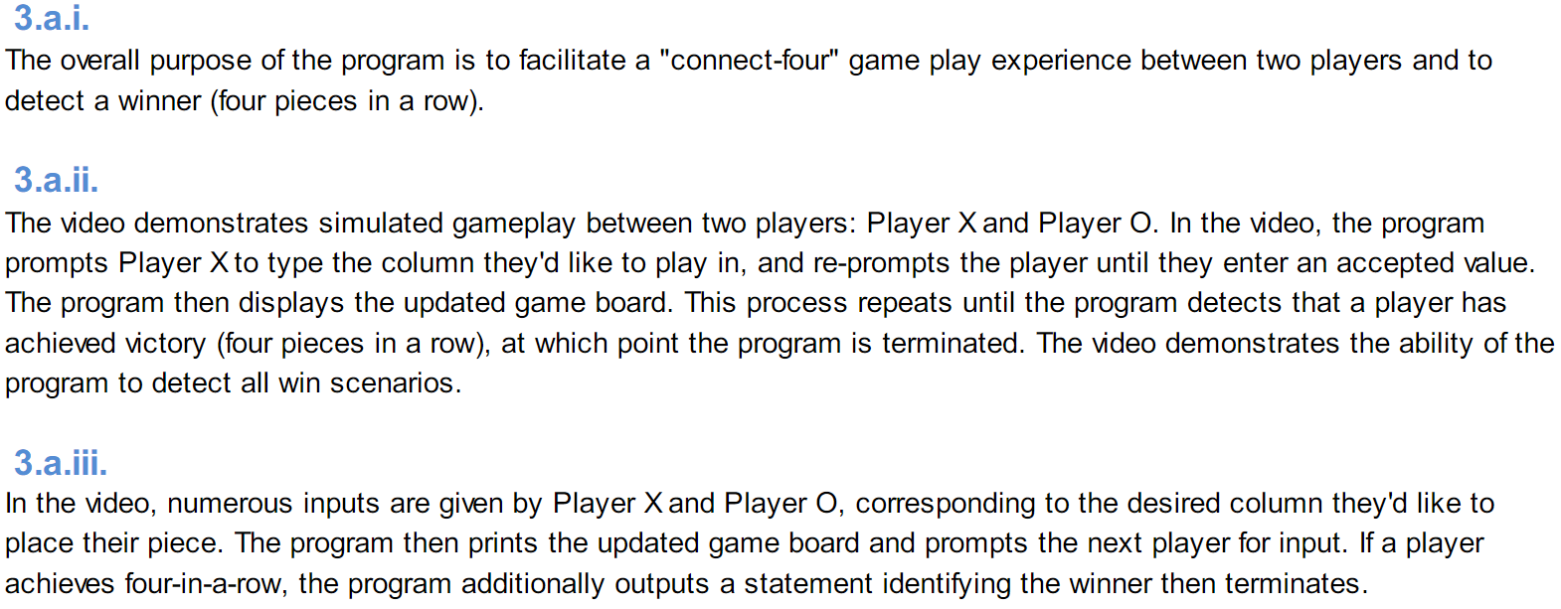
a
video a
The video demonstrates the running of the program including:
  input
  program functionality
  output
The written response:
  describes the overall purpose of the program
  describes what functionality of the program is demonstrated in the video
  describes the input and output of the program demonstrated in the video
?

Slide 6
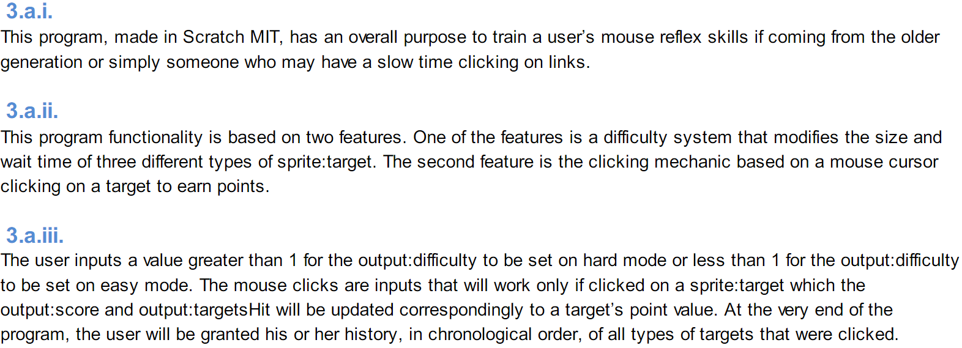
b
video b
The video demonstrates the running of the program including:
  input
  program functionality
  output
The written response:
  describes the overall purpose of the program
  describes what functionality of the program is demonstrated in the video
  describes the input and output of the program demonstrated in the video
?

Slide 7
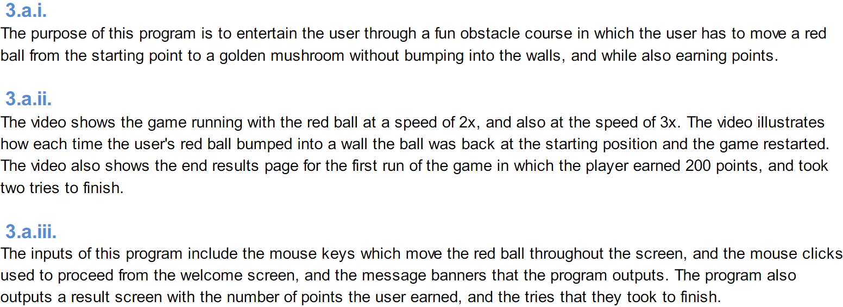
c
video c
The video demonstrates the running of the program including:
  input
  program functionality
  output
The written response:
  describes the overall purpose of the program
  describes what functionality of the program is demonstrated in the video
  describes the input and output of the program demonstrated in the video
?

Slide 8
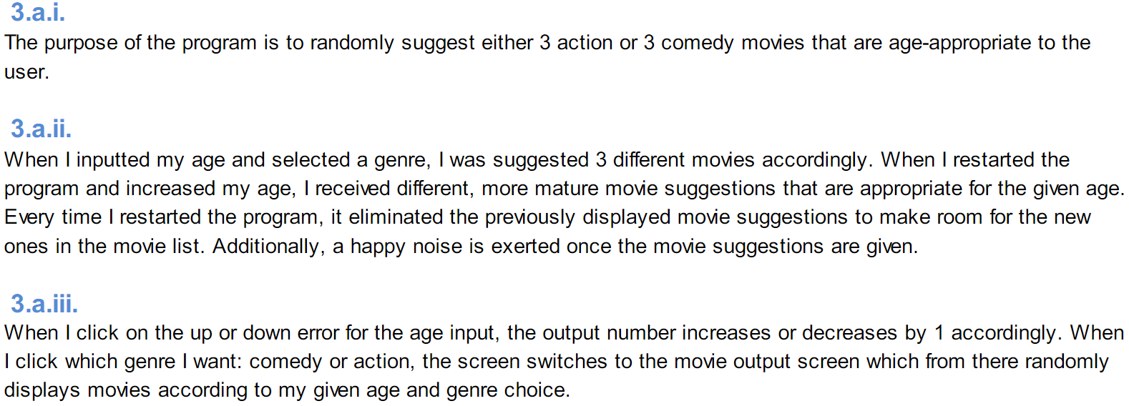
d
video d
The video demonstrates the running of the program including:
  input
  program functionality
  output
The written response:
  describes the overall purpose of the program
  describes what functionality of the program is demonstrated in the video
  describes the input and output of the program demonstrated in the video
?

Slide 9
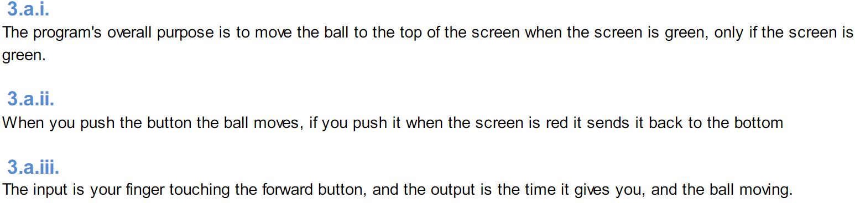
e
video e
The video demonstrates the running of the program including:
  input
  program functionality
  output
The written response:
  describes the overall purpose of the program
  describes what functionality of the program is demonstrated in the video
  describes the input and output of the program demonstrated in the video
?

Slide 10
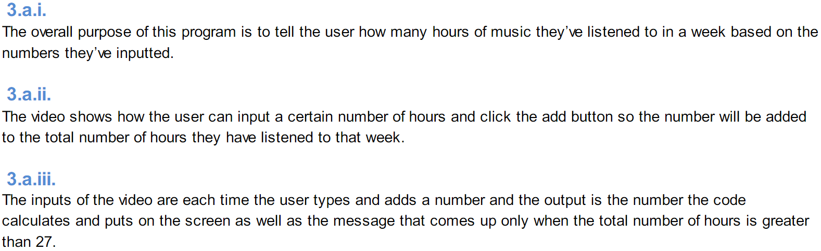
f
video f
The video demonstrates the running of the program including:
  input
  program functionality
  output
The written response:
  describes the overall purpose of the program
  describes what functionality of the program is demonstrated in the video
  describes the input and output of the program demonstrated in the video
?

Slide 11
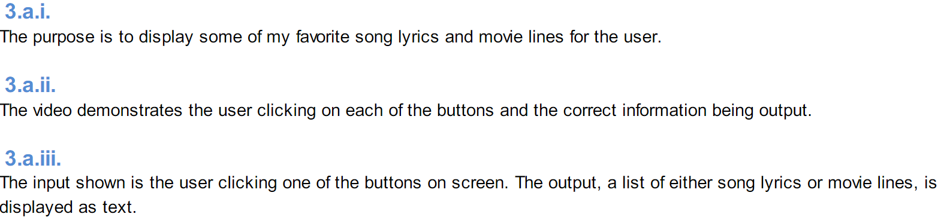
g
video g
The video demonstrates the running of the program including:
  input
  program functionality
  output
The written response:
  describes the overall purpose of the program
  describes what functionality of the program is demonstrated in the video
  describes the input and output of the program demonstrated in the video
?

Slide 12
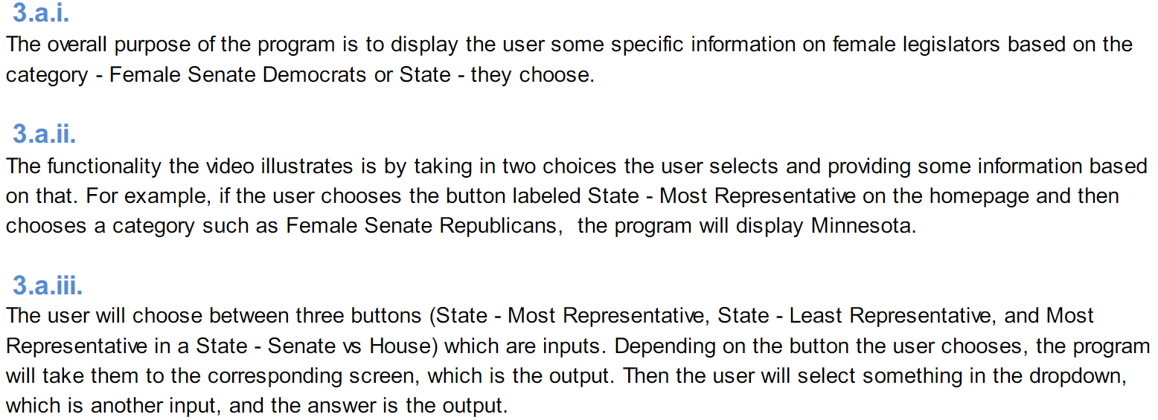
h
video h
The video demonstrates the running of the program including:
  input
  program functionality
  output
The written response:
  describes the overall purpose of the program
  describes what functionality of the program is demonstrated in the video
  describes the input and output of the program demonstrated in the video
?

Slide 13
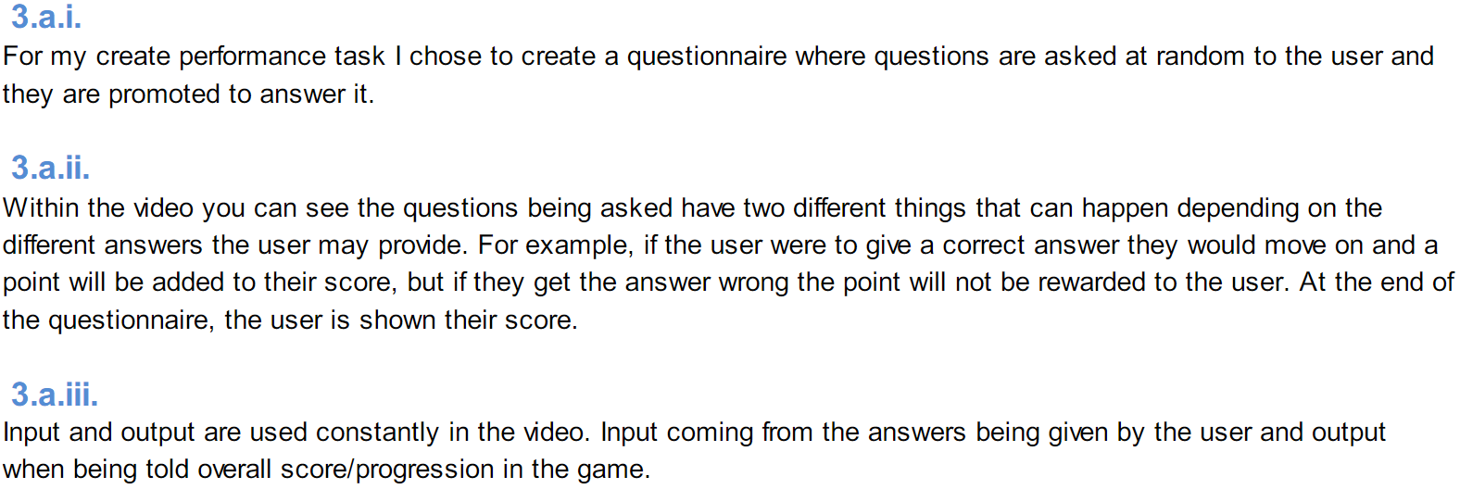
i
video i
The video demonstrates the running of the program including:
  input
  program functionality
  output
The written response:
  describes the overall purpose of the program
  describes what functionality of the program is demonstrated in the video
  describes the input and output of the program demonstrated in the video
?

Slide 14
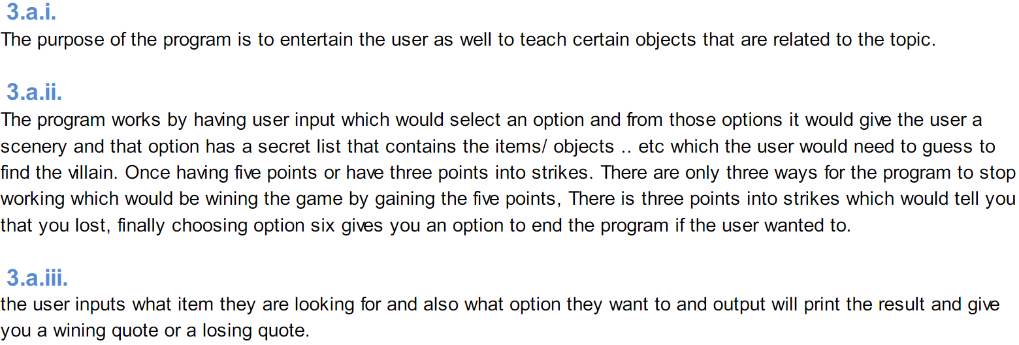
j
video j
The video demonstrates the running of the program including:
  input
  program functionality
  output
The written response:
  describes the overall purpose of the program
  describes what functionality of the program is demonstrated in the video
  describes the input and output of the program demonstrated in the video
?

